Slide 1
UNIT 12
LEARNERS WITH PHYSICAL DISABILITIES
Grammar and vocabulary (with key)

Slide 2
VOCABULARY
Read the text on pages 74 and 75.
Refer to page 77 (Vocabulary) for any new words or phrases.
Do exercises III and IV on page 75.

Slide 3
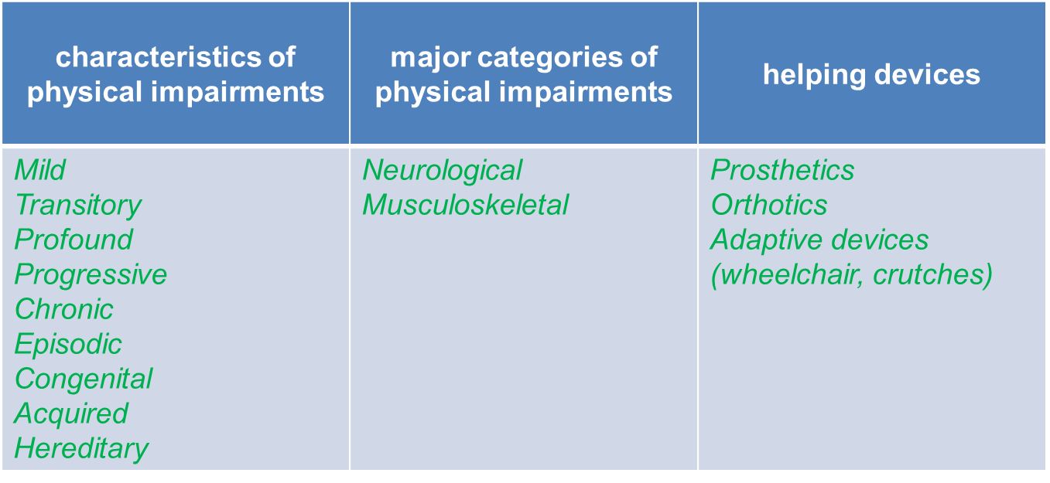
Exercise III page 75 (Key)
FILL IN THE TABLE WITH WORDS AND EXPRESSIONS FROM THE TEXT

Slide 4
Exercise IV page 75 (Key)
MATCH THE FOLLOWING WORDS WITH THEIR DEFINITIONS
developing gradually over a period of time – progressive
existing for only a short time – transitory
occurring in episodes – episodic
very serious – profound
a permanent condition – chronic
not serious – mild

Slide 5
GRAMMAR
REPORTED QUESTIONS
(page 77)

Slide 6
REPORTING QUESTIONS
WORD ORDER OF A STETEMENT:
“What do you do in your spare time?”
He asked me what I did in my spare time.
WH QUESTIONS KEEP QUESTION WORDS WHEN THEY ARE REPORTED:
He asked me what I did in my spare time.
He wanted to know where I was going.
YES/NO QUESTIONS ARE REPORTED WITH IF OR WHETHER
“Are you willing to travel?”
She asked if/whether I was wiling to travel.
The same sequence of tenses is applied as when reporting statements (see Unit 11)

Slide 7
EXERCISE VI page 76 (Key)
REPORT THE FOLLOWING QUESTIONS.
She asked me what many individuals with physical impairments used. (*no question form! What + S + V)
He wanted to know what physical disabilities could be like.
They asked me if he had used adaptive devices before. (*if/whether when we report a yes/no question – if + S + V)
They asked her whether the doctors had diagnosed her child with epilepsy.
He wanted to know how she would learn to use adaptive devices.
They asked what special equipment the school had to provide for students with physical disabilities.
She wanted to know if/whether they were attending a special or a regular school.
They asked if/whether he had used any helping devices before he had started therapy.

Slide 8
EXTRA EXERCISE 1: REPORT THE FOLLOWING QUESTIONS FROM A JOB INTERVIEW
Are you married?
How old are you?
Which university are you studying at?
Where do you come from?
Have you worked with children before?
What sports do you play?
Will you work for at least two months?
Can you start immediately?
Do you need accommodation?
Would you like any more information?

Slide 9
EXTRA EXERCISE 2: You have been away for a while and have just come back to your home town. You meet Tony, a friend of yours. He asks you a lot of questions. Tell another friend what Tony asked you.
How are you?
Where have you been?
How long have you been back?
What are you doing now?
Why did you come back?
Where are you living?
Are you glad to be back?
Do you have any plans to go away again?
Can you lend me some money?

Slide 10
EXTRA EXERCISE 1 - KEY
The interviewer wanted to know…
…if I was married.
…how old I was.
…which university I was studying at.
…where I came from.
…if I had worked with children before.
…what sports I played.
…if I would work for at least six months.
…if I could start immediately.
…if I needed accommodation.
…if I would like any more information.

Slide 11
EXTRA EXERCISE 2 - KEY
Tony asked me…
…how I was.
…where I had been.
…how long I had been back.
…what I was doing then.
…why I had come back.
…where I was living.
…if I was glad to be back.
…if I had any plans to go away again.
… if I could lend him some money.

